Slide 1
VencoPy Dev kick-off
Niklas Wulff
Stuttgart, 2021

Slide 2
Modeling pipeline and structure
> Niklas Wulff • Ph.D. Presentation
Fleets
Electric vehicle fleet flexibility
Energy system investment and operation
Mobility surveys
Technical Assumptions

Slide 3
Motivation – findings from literature (power sector)
> Niklas Wulff
- 9.2% reduction in grid capacities (Luca de Tena & Pregger, 2018)
- 0.9% - +2.69% in total capacity expansion in time horizon 2020-2050 (Taljegard et al. 2019)
- 9.28 % - +10.31% new interconnectors in time horizon 2020-2050 (Taljegard et al. 2019)
- 6 TWh system losses (Luca de Tena & Pregger, 2018)
- 1.6-1.8 TWh system losses (Gnann et al., 2018)
- 19.05 % reduced wind power curtailment in 2030 (Taljegard et al. 2019), total curtailed wind power in base: 2%
Technology capacity
Curtailment
Reduced peak power
System costs
- 4.5 GW (Luca de Tena & Pregger, 2018)
-2.2-+0.76 GW (Gnann et al., 2018)
-3-9 GW (21-59 %) reduced investments in peaking capacity in time horizon 2020-2050 (Taljegard et al. 2019),
850 bn. € system cost savings (Luca de Tena & Pregger, 2018)
0-12 % increased system cost from operation in 2030 (Taljegard et al. 2019)
5-12 % increased system cost from investment modeling (Taljegard et al. 2019)
Notes:
Changes in Gnann et al. Stem from only charging at home,
Changes in Taljegaard et al. Stem from doubling the EV power demand (100-200 TWh/a with the same capacity)

Slide 4
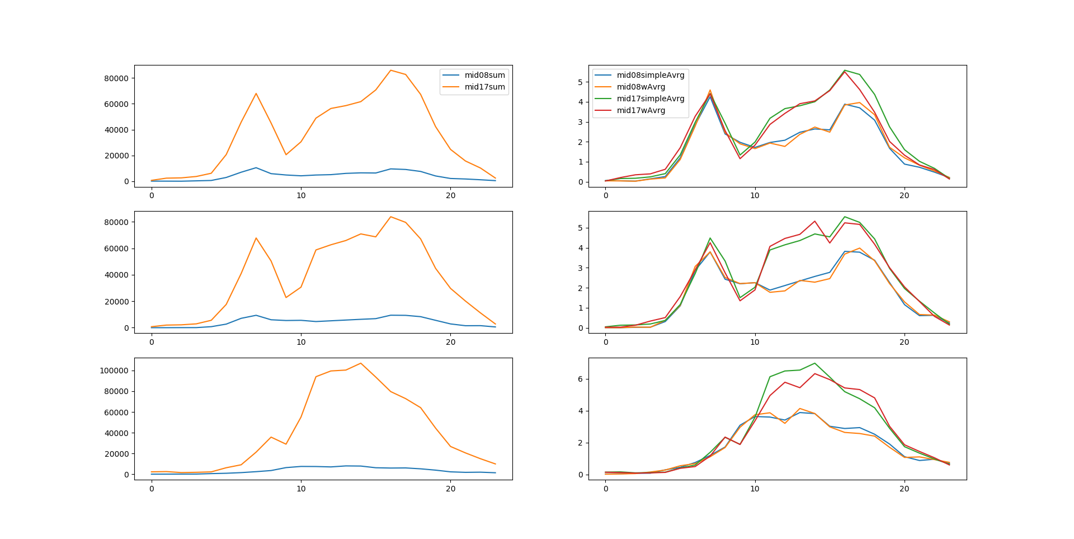
The influence of weighting trips is negligible compared to the difference between mobility patterns from 2008 and 2017
> Niklas Wulff • Ph.D. Presentation
N=143,699
N=17,863
MONDAY
THURSDAY
Absolute km driven in sample
Average hourly triplength in km
SATURDAY
Notes:
This is true for both weekends and workdays

Slide 5
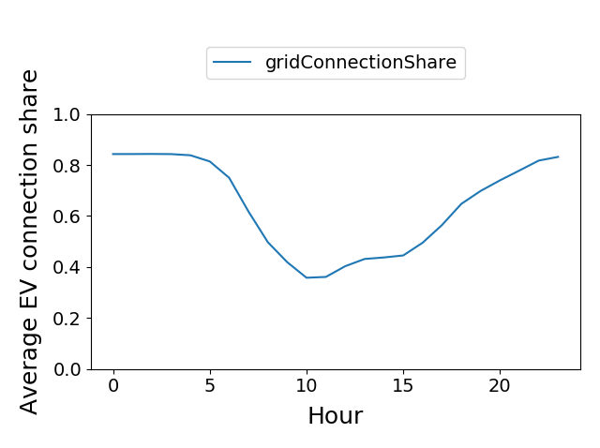
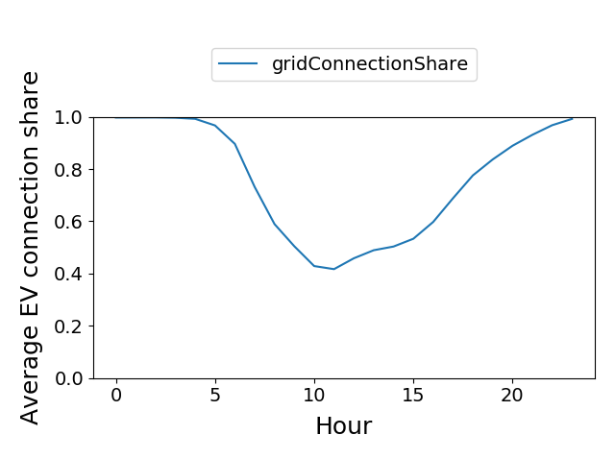

Comparing grid connections on the background of the data bases MiD2008 vs. MiD2017 (assumption: Only home charging with 11 kW)
> Niklas Wulff • Ph.D. Presentation
In processed MiD08 dataset, 2637 of 16151 trips are not @home at 3am (realistic?)
Changes in grid connection are steeper based on newer mobility patterns. Average minimum connection capacity is slightly higher

Slide 6
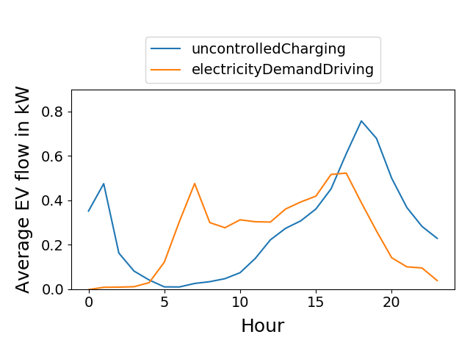
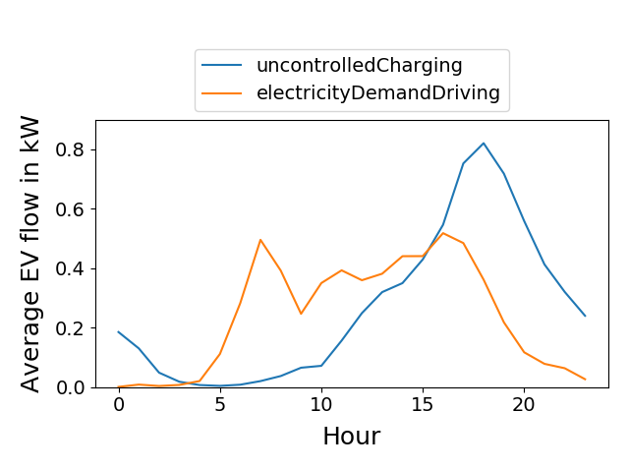
Comparing consumption and uncontrolled charging on the background of the data bases MiD2008 vs. MiD2017
> Niklas Wulff • Ph.D. Presentation
Morning and evening peak consumptions are wider, uncontrolled charging is higher but peaks at same time (19:00)

Slide 7
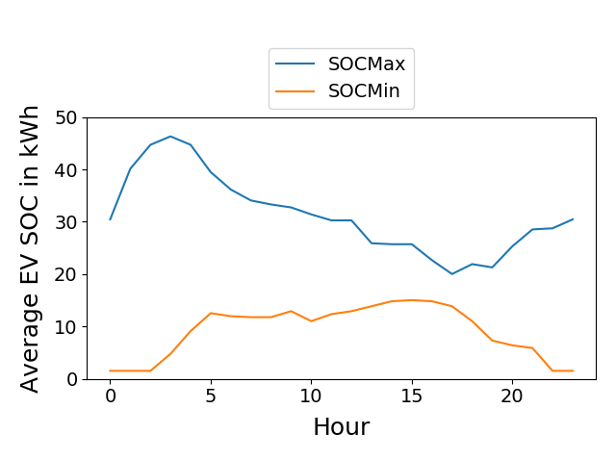
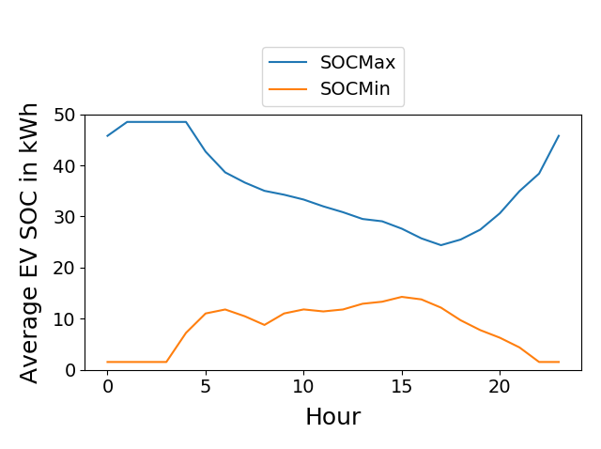
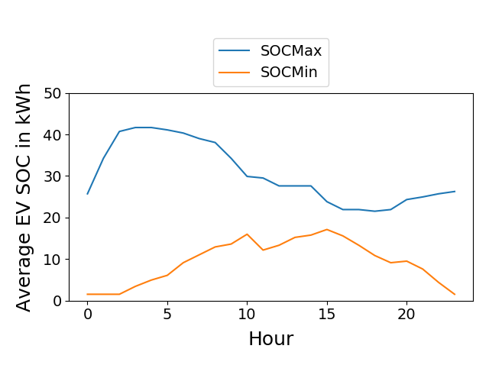
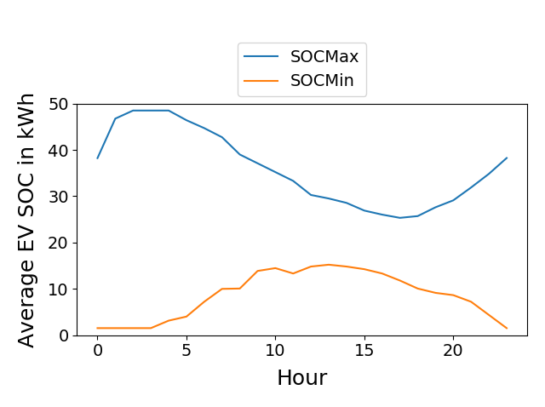
Comparing different weekdays (Thursday, Saturday)
> Niklas Wulff • Ph.D. Presentation
MiD08
MiD17
THURSDAY
SATURDAY
Weekend minimum flexibility occurs between 10:00 and 19:00 while weekday minimum flexibility occurs from 6:00 to ~18:00

Slide 8
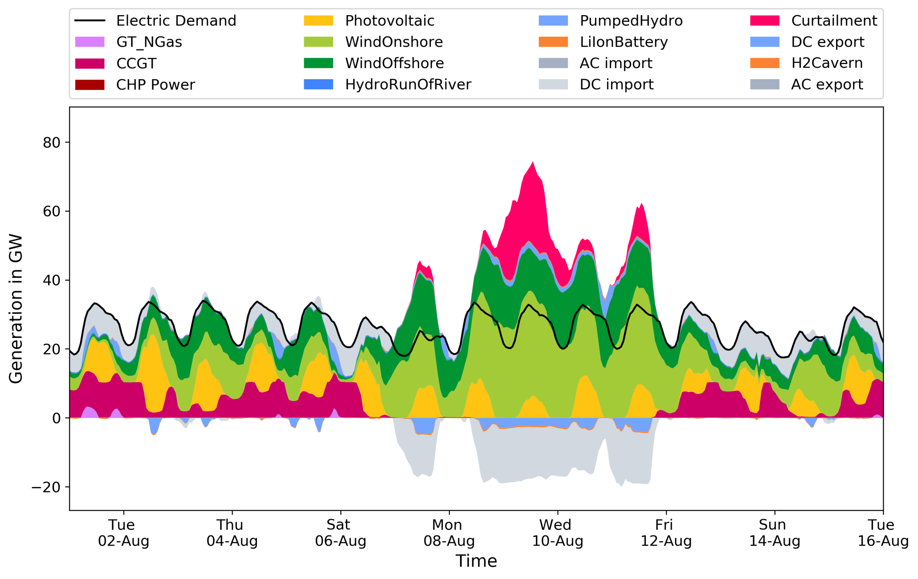
Preliminary results – MR0 vs. MR1
> Niklas Wulff
Dispatch

Slide 9
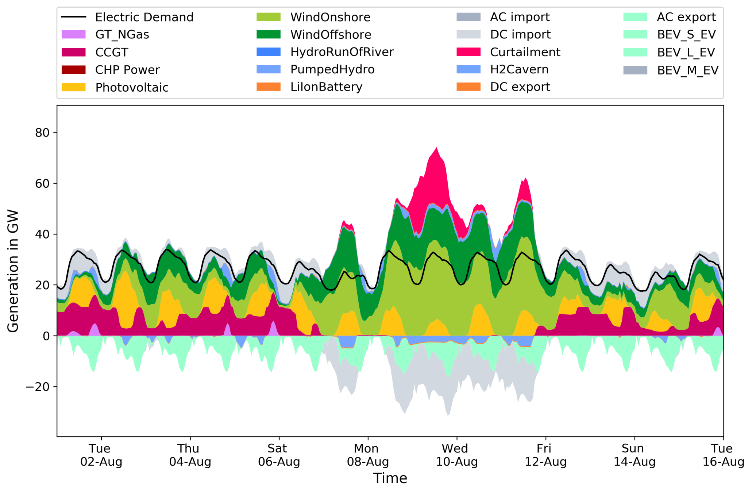
Preliminary results – MR0 vs. MR1
> Niklas Wulff
Dispatch

Slide 10
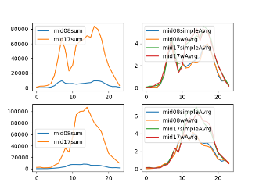
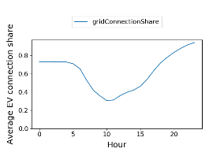
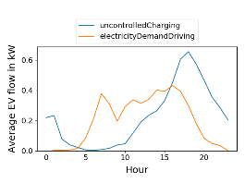
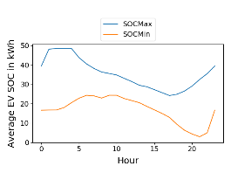
Current structure
> Niklas Wulff • Ph.D. Presentation
MiD2017
parsingMiD.py
inputProfiles_Drive_MiD17.csv
evaluateDriveProfiles.py
Trips
utilsParsing
inputProfiles_Purpose_MiD17.csv
Persons
utilsTimestamp
Households
VencoPy Config.yml
main
assignChargingInfra.py
libraries
Battery size
Specific electric consumption
inputProfiles_Plug_MiD17.csv
VencoPy
VencoPy_scalarInput.xlsx
Notes:
Besetzungsgrad (person/vehicle) sunk from 1.5 to 1.4 from 2002 to 2017
Neaimeh et al. (2017): 29 Nissan Leafs, 6 Renault Zoe

Slide 11
Current structure
v: Vehicle,
t: Timestep
Mileage (v,t) in km
MiD
Trip diary composition
Flexibility calculation
Parsing
Grid connection (v,t) in (True, False)
Infrastructure assignment
Profile
Profile
Profile
Profile
Profile
Profile
Config

Slide 12
Current feature backlog
Including temperature dependency
Differentiating between connection potential and connection (possibly using data from Flammini et al.)
Different aggregation schemes (possibly based on Zungfei Wang et al.)
Temporally dependent day-to-year composition
Adequate weighting
Include household-to-car allocation by Anton Galich (VF)
Additional differentiations
Geography
Socio-economics
…
Validation

Slide 13
Feature dev priorities
Shortcomings
Aggregation schemes
Integration of person-vehicle mapping and vehicle-size dependence
Temporally dependent day-to-year composition
Project needs
Modeling U-Shift
Freight transportation: Data challenge, integration in REMix relatively easy
Public transportation: Data is available but how would we integrate this in REMix?

Slide 14
Application context and interfaces to projects and Ph.D.s
Use in and before 2020
Use likely in 2021
Projects
Ph.D.s
VencoPy tool
BEniVer
Niklas
EVer
Fabia
ENavi
VENCO data (from 2010?)
Farzad
All other
Manuel
Kien
Shima
Felix?
..and all others

Slide 15
Development timeline
Alpha release
0.8
Q4 2021
Alpha post-release
0.8.5
March 2020
Beta release
0.9
Summer 2021
Full release
1.0.0
Q1 2022?
…

Slide 16
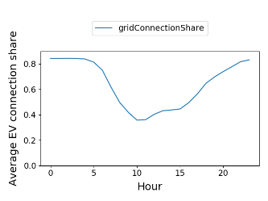
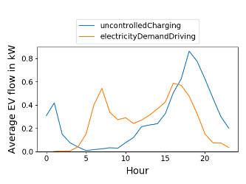
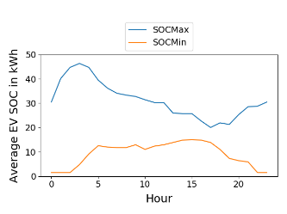
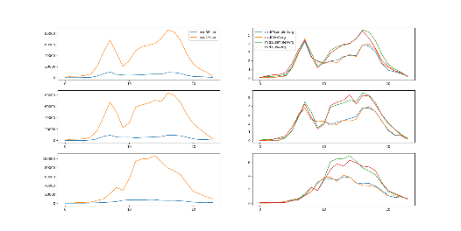
Step-by-step procedure in analysing the MiD dataset and estimating BEV fleet electric load flexibility
> Niklas Wulff • Ph.D. Presentation
Step 1: Parsing, Filtering, trip diary creation
Step 2: Infrastructure assumptions and plug-in behavior
Step 4:
Charging flexibility estimation
MiD data
Step 3: Evaluation of drive and plug profiles
driveProfiles
purposeProfiles
Improvement potential
Automatic variable filtering (e.g. socio-economics)
plugProfiles
Assumptions
Notes:
Besetzungsgrad (person/vehicle) sunk from 1.5 to 1.4 from 2002 to 2017
Neaimeh et al. (2017): 29 Nissan Leafs, 6 Renault Zoe

Slide 17
Vehicle Energy in Python (VencoPy) – resulting profiles
Grid
Controlled charging
Uncontrolled charging
Consumption
Grid connection
SOC Max
SOC Min
Battery
SOC Max
SOC Min
Demand
Notes:
Thresholds: Minimum daily mileage, minimum annual mileage, consideration threshold for fuel use

Slide 18
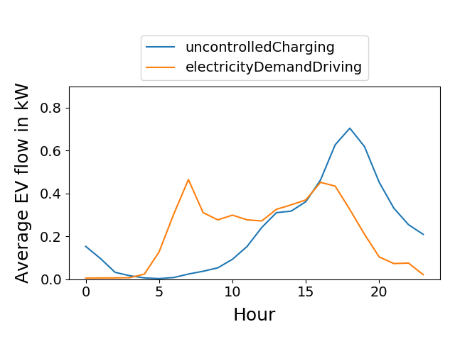
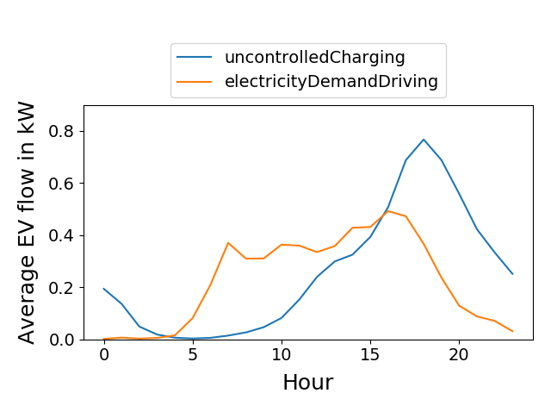
Comparing consumption and uncontrolled charging on the background of the data bases MiD2008 vs. MiD2017
> Niklas Wulff • Ph.D. Presentation
Electricity demand for driving is less concentrated, uncontrolled charging is slightly higher but peaks at same time (19:00)

Slide 19
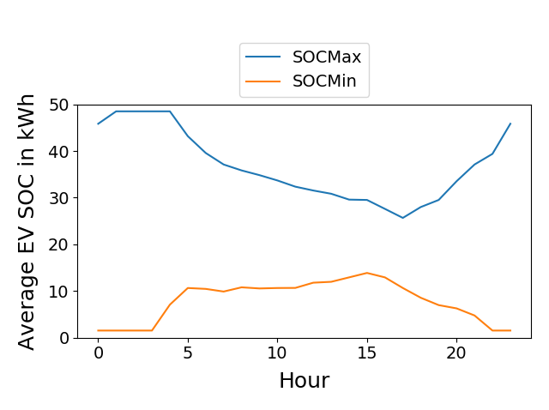
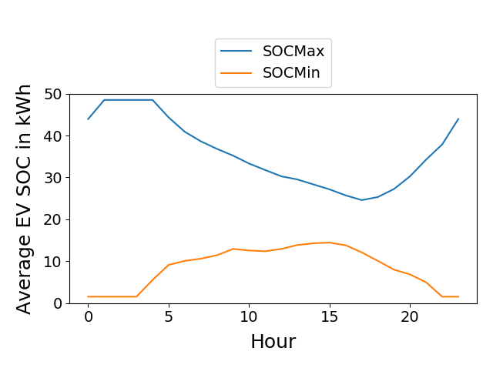
State-of-charge comparison
> Niklas Wulff • Ph.D. Presentation
MiD08
MiD17

Slide 20
Conceptual ideas for validation
> Niklas Wulff • Ph.D. Presentation
Mobility patterns: Comparison of aggregate values (MiD-based vs. EV mobility)
Trips / day
Distance / day
EV flexibility: Comparison of aggregate values (VencoPy results vs. EV pilot data)
Grid connection and plug-in assumptions: Average daily grid connection, minimum and maximum charging capacity
Electric consumption: Overall daily or annual consumption via charging energy
Uncontrolled charging: Average daily charging, minimum and maximum charging
State-of-charge profiles: Proof that demand can be fulfilled by both curves
EV flexibility: Comparison of profiles (VencoPy results vs. EV pilot data)
Grid connection
Uncontrolled charging
Notes:
Distance per day: 61 (UK) vs. 43 (UKNTS) [Neaimeh et al. (2017)]

Slide 21
Structure
Option 2
Class vpParse
vpP = vpParse(linkToMiD, parseCfg)
vpP.parse()
Class vpDiary
vpD = vpDiary(vpP.data, tripConfig)
Option 1
Class vencopy
Vp = vencopy()
Vp.parse()
Vp.composeDiary()
Vp.connectGrid()
Vp.estimateFlexibility()
Class vpGrid
vpG = vpGrid(vpP.data, gridConfig)
Class vpFlexEstimator
vpF = vpFlexEstimator(vpD.data, vpG.data, flexConfig)

